Slide 1
Twitter Stock Market Sentiment Analysis
MET CS 688
Venkata Vishnuvardhan Aluri

Slide 2
What is Sentiment Analysis?
Sentiment analysis refers to the use of natural language processing, text analysis, computational linguistics, and biometrics to systematically identify, extract, quantify, and study affective states and subjective information.
Generally speaking, sentiment analysis aims to determine the attitude of a speaker, writer, or other subject with respect to some topic or the overall contextual polarity or emotional reaction to a document, interaction, or event.

Slide 3

Twitter
Twitter is an American online news and social networking service on which users post and interact with messages known as "tweets“.
It has 3.19 million monthly active users.
Created in March, 2006.
In R, API can be accessed using twitteR and ROAuth libraries.

Slide 4
Overview
Acquire stock details from stock market API
Classify gainers and losers
Fetch tweets from twitter API
Building Corpus and pre-processing
DTM and Word Cloud
Sentiment Analysis
Plots and Analysis

Slide 5
Data
Stocks of six banks are chosen
JP Morgan
Wells Fargo
Citi
Goldman Sachs
U. S. Bancorp
Bank of America

Slide 6
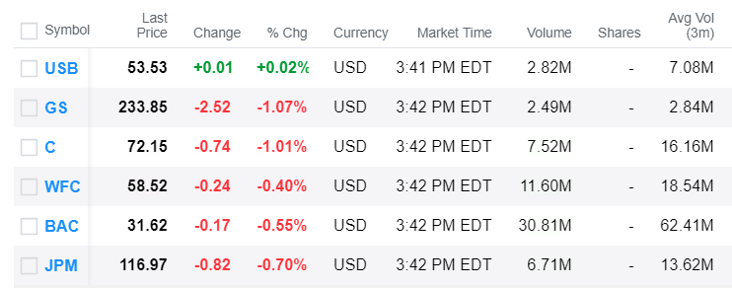
Stock Details

Slide 7
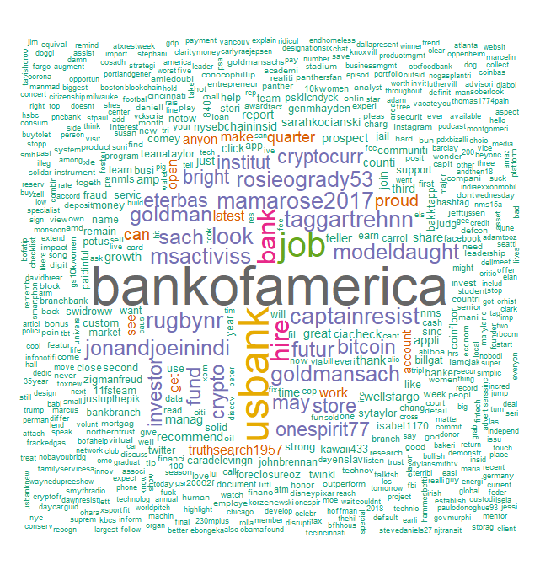
Word Cloud - Gainers

Slide 8
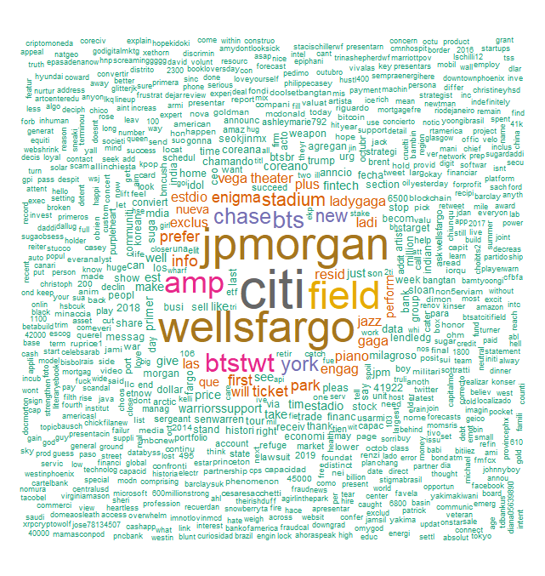
Word Cloud - Losers

Slide 9
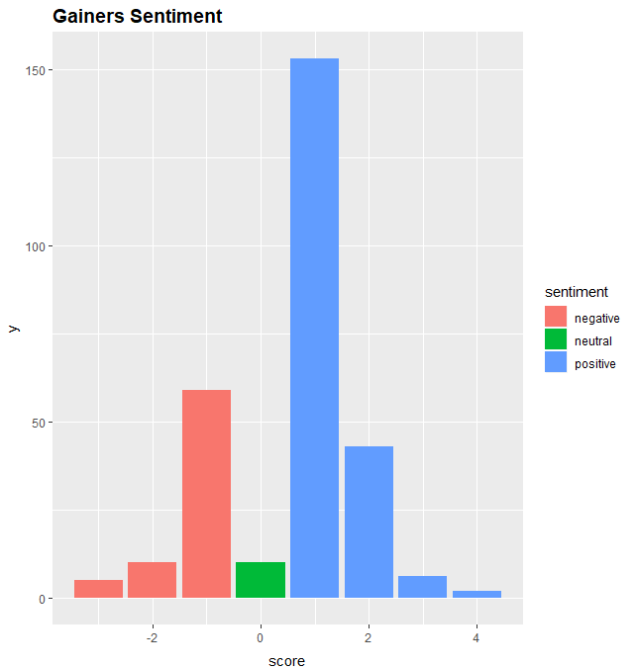
Bar plot for Gainers

Slide 10
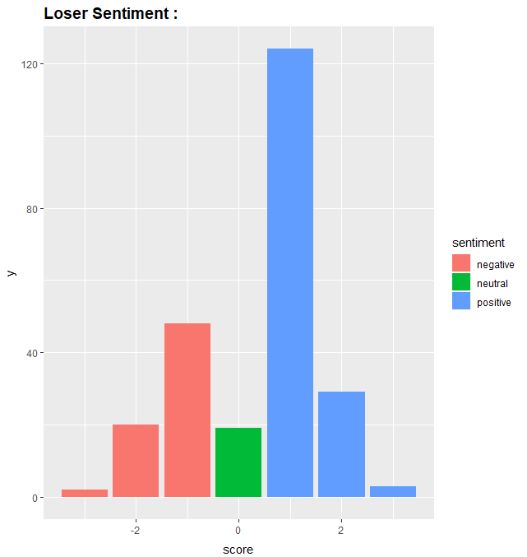
Bar plot for Losers

Slide 11
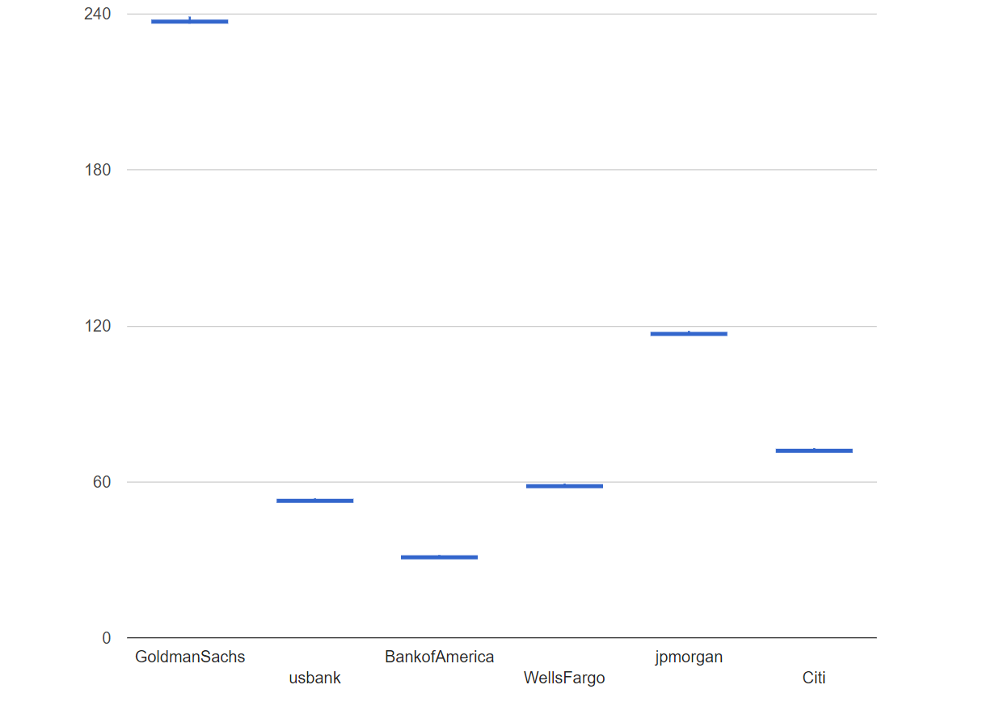
Candlestick plot

Slide 12
Candlestick chart inference
The candlesticks are very small because opening price and closing price difference of stocks is very less.
If the closing price is lower than the opening price, then the candlestick is filled.
If the closing price is higher than the opening price, then the candlestick is hallow.

Slide 13
What else can be done?
Relation between how tweets impact stocks might also be predicted using correlation analysis and linear regression modelling.
Stock charts over a period of time may give more insights.

Slide 14
Thank you!

